Slide 1
Amit Graduation Project
Done by:Mohamed Gamal
Group:Q10

Slide 2
Objective
The main objective of this project is to understand the communication protocols and to be able to use them to send and receive data

Slide 3
Method
Use UART communication to receive data from Virtual terminal
Send the received data from one microcontroller to another using SPI
The received data is used to operate a LED

Slide 4
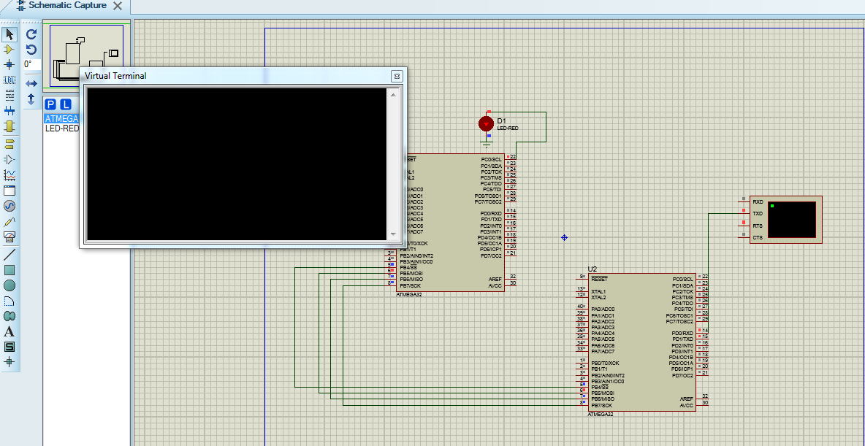
Simulation

